Slide 1
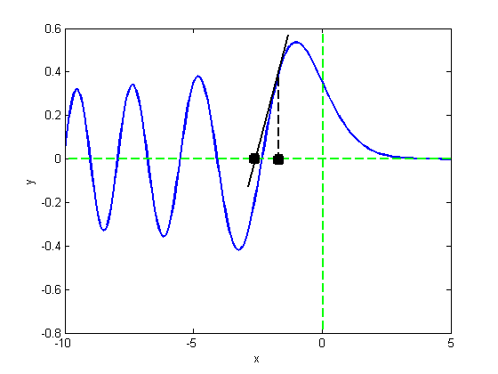
Chapter 4
Rootfinding

Slide 2
Return to fzero: how it works
Fzero uses a bracketing method for a few steps
Method of bisection finds an interval containing the root, and may narrow it
Then, inverse quadratic interpolation is used to converge to the root
This has the advantage of a slow but robust method (bisection) getting close to the root so the fast method (IQI) takes over
Let’s see details of fzero…

Slide 3
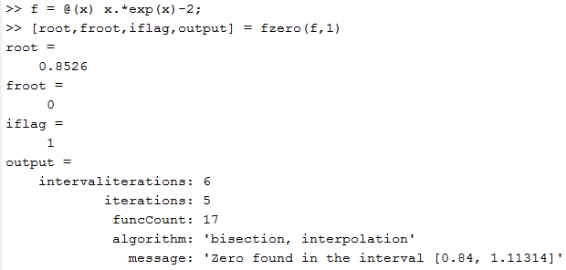
Return to fzero: how it works
Use $f(x)=xe^{x} −2$ bisection, then IQI

Slide 4
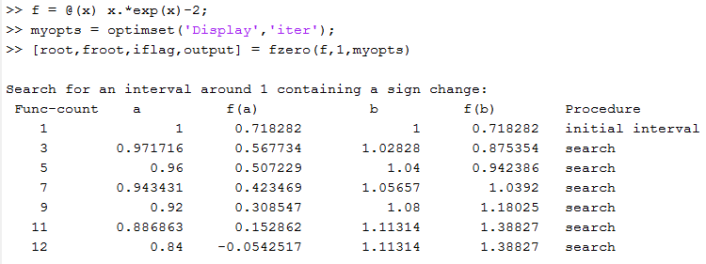
Return to fzero: how it works
Now set ‘Display’ to ‘iter’ to see details
Fzero makes an interval until a sign change found

Slide 5
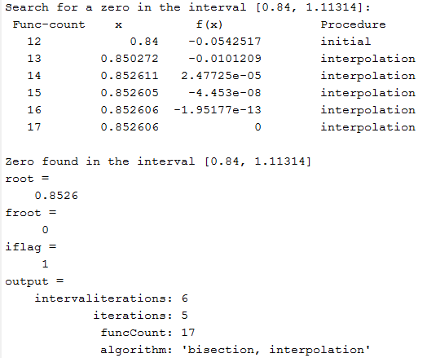
Return to fzero: how it works
Endpoints where sign change happened plus initial point become three points for starting IQI
Then iterate using IQI

Slide 6
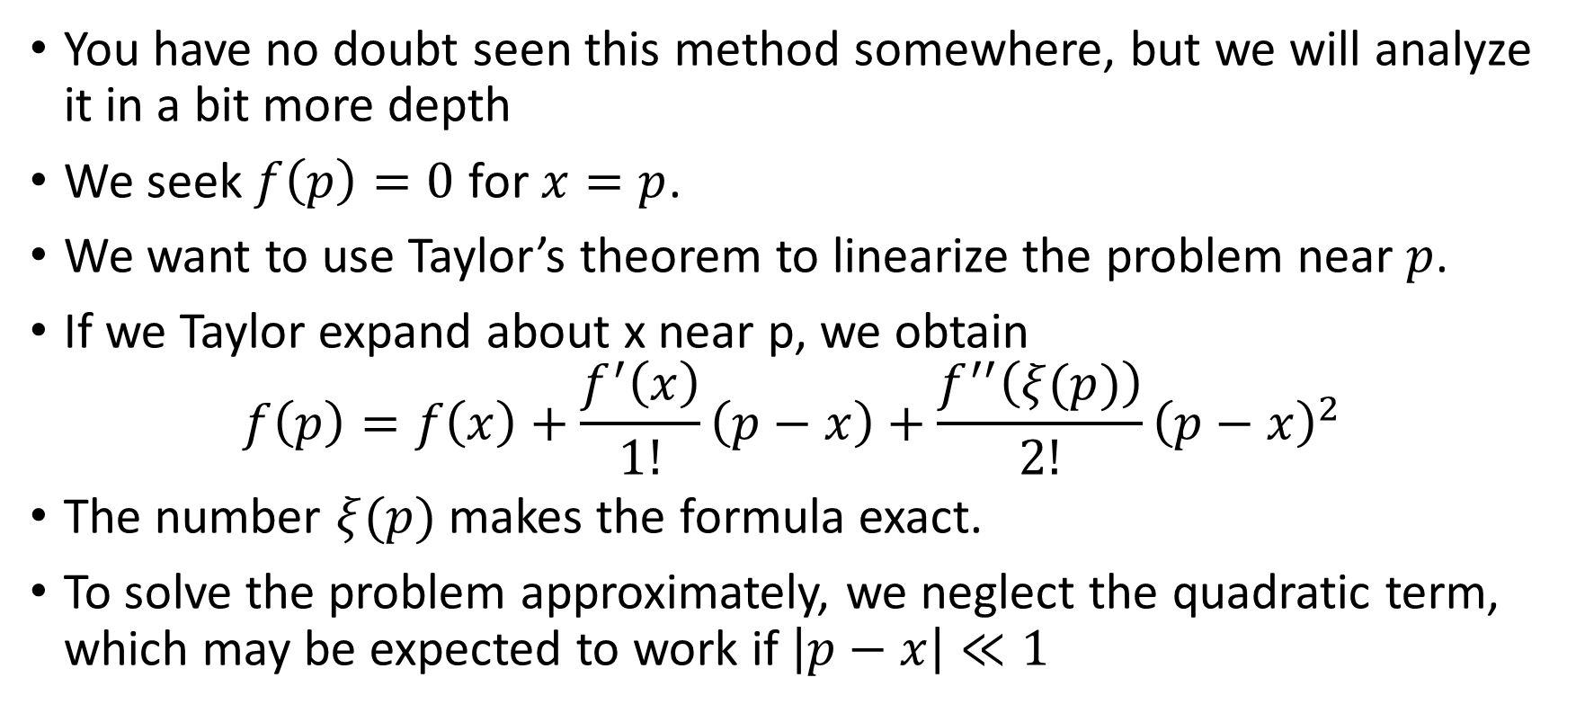
Root finding: Newton’s method
You have no doubt seen this method somewhere, but we will analyze it in a bit more depth
We seek $f\left(p\right)=0$ for $x=p$.
We want to use Taylor’s theorem to linearize the problem near $p$.
If we Taylor expand about x near p, we obtain
$$f\left(p\right)=f\left(x\right)+\frac{f^{′}\left(x\right)}{1!}\left(p−x\right)+\frac{f^{′′}\left(ξ(p)\right)}{2!}{\left(p−x\right)}^{2}$$
The number $ξ(p)$ makes the formula exact.
To solve the problem approximately, we neglect the quadratic term, which may be expected to work if $\left|p−x\right|≪1$

Slide 7
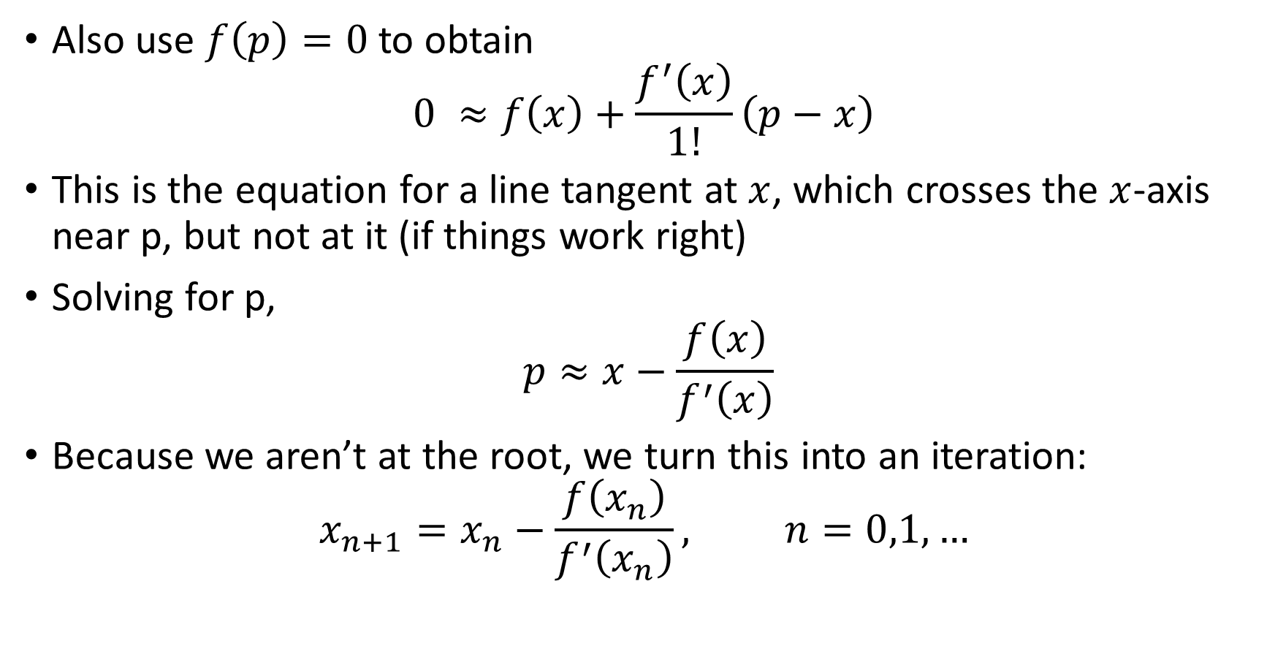
Root finding: Newton’s method
Also use $f\left(p\right)=0$ to obtain
$$0 ≈f\left(x\right)+\frac{f^{′}\left(x\right)}{1!}\left(p−x\right)$$
This is the equation for a line tangent at $x$, which crosses the $x$-axis near p, but not at it (if things work right)
Solving for p,
$$p≈x−\frac{f\left(x\right)}{f^{′}\left(x\right)}$$
Because we aren’t at the root, we turn this into an iteration:
$$x_{n+1}=x_{n}−\frac{f\left(x_{n}\right)}{f^{′}\left(x_{n}\right)}, n=0,1,…$$

Slide 8
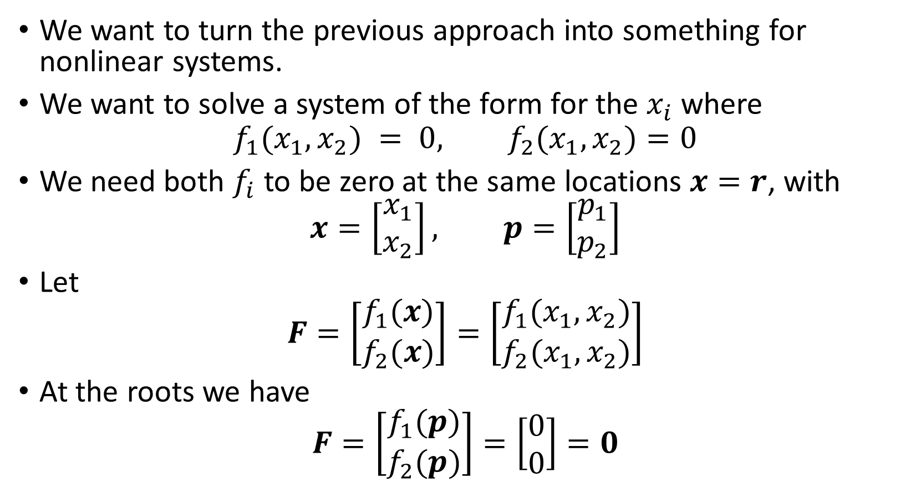
Newton’s method for systems
We want to turn the previous approach into something for nonlinear systems.
We want to solve a system of the form for the $x_{i}$ where
$$f_{1}(x_{1},x_{2}) = 0, f_{2}(x_{1},x_{2})=0$$
We need both $f_{i}$ to be zero at the same locations $x=r$, with
$$x=\left[\begin{matrix}x_{1} \\ x_{2}\end{matrix}\right], p=\left[\begin{matrix}p_{1} \\ p_{2}\end{matrix}\right]$$
Let
$$F=\left[\begin{matrix}f_{1}(x) \\ f_{2}(x)\end{matrix}\right]=\left[\begin{matrix}f_{1}(x_{1},x_{2}) \\ f_{2}(x_{1},x_{2})\end{matrix}\right]$$
At the roots we have
$$F=\left[\begin{matrix}f_{1}(p) \\ f_{2}(p)\end{matrix}\right]=\left[\begin{matrix}0 \\ 0\end{matrix}\right]=0$$

Slide 9
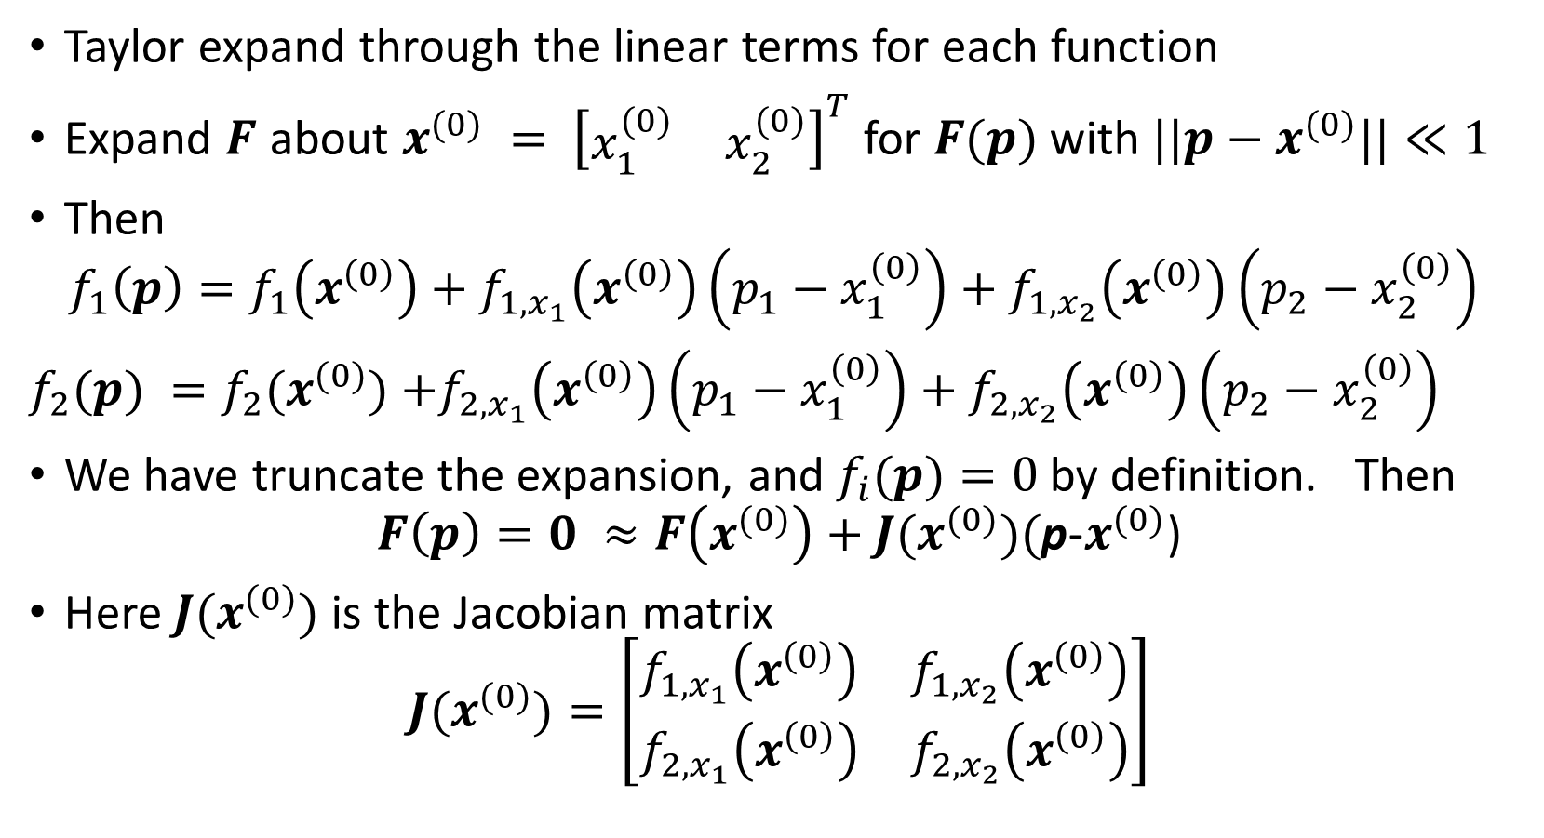
Newton’s method for systems
Taylor expand through the linear terms for each function
Expand $F$ about $x^{(0)} = {\left[\begin{matrix}x_{1}^{(0)} & x_{2}^{(0)}\end{matrix}\right]}^{T}$for $F(p)$ with $||p−x^{(0)}||≪1$
Then
$$f_{1}\left(p\right)=f_{1}\left(x^{\left(0\right)}\right)+f_{1,x_{1}}\left(x^{\left(0\right)}\right)\left(p_{1}−x_{1}^{\left(0\right)}\right)+f_{1,x_{2}}\left(x^{\left(0\right)}\right)\left(p_{2}−x_{2}^{\left(0\right)}\right)$$
$f_{2}(p) =f_{2}(x^{(0)})$ $+f_{2,x_{1}}\left(x^{\left(0\right)}\right)\left(p_{1}−x_{1}^{\left(0\right)}\right)+f_{2,x_{2}}\left(x^{\left(0\right)}\right)\left(p_{2}−x_{2}^{\left(0\right)}\right)$
We have truncate the expansion, and $f_{i}(p)=0$by definition. Then
$$F\left(p\right)=0 ≈F\left(x^{(0)}\right)+J(x^{(0)})(\text{p}\text{−}x^{(0)}\text{)}$$
Here $J(x^{(0)})$ is the Jacobian matrix
$$J(x^{(0)})=\left[\begin{matrix}f_{1,x_{1}}\left(x^{\left(0\right)}\right) & f_{1,x_{2}}\left(x^{\left(0\right)}\right) \\ f_{2,x_{1}}\left(x^{\left(0\right)}\right) & f_{2,x_{2}}\left(x^{\left(0\right)}\right)\end{matrix}\right]$$

Slide 10
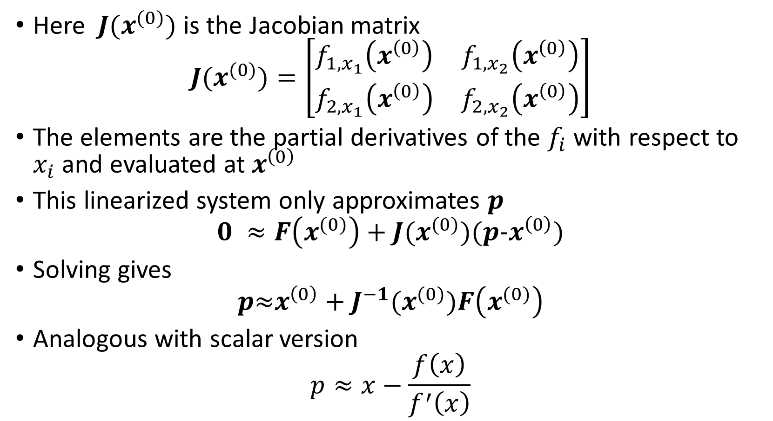
Newton’s method for systems
Here $J(x^{(0)})$ is the Jacobian matrix
$$J(x^{(0)})=\left[\begin{matrix}f_{1,x_{1}}\left(x^{\left(0\right)}\right) & f_{1,x_{2}}\left(x^{\left(0\right)}\right) \\ f_{2,x_{1}}\left(x^{\left(0\right)}\right) & f_{2,x_{2}}\left(x^{\left(0\right)}\right)\end{matrix}\right]$$
The elements are the partial derivatives of the $f_{i}$ with respect to $x_{i}$ and evaluated at $x^{\left(0\right)}$
This linearized system only approximates $p$
$$0 ≈F\left(x^{(0)}\right)+J(x^{(0)})(p\text{−}x^{\left(0\right)}\text{)}$$
Solving gives
$$p\text{≈}x^{\left(0\right)}+J^{−1}(x^{(0)})F\left(x^{(0)}\right)$$
Analogous with scalar version
$$p≈x−\frac{f\left(x\right)}{f^{′}\left(x\right)}$$

Slide 11
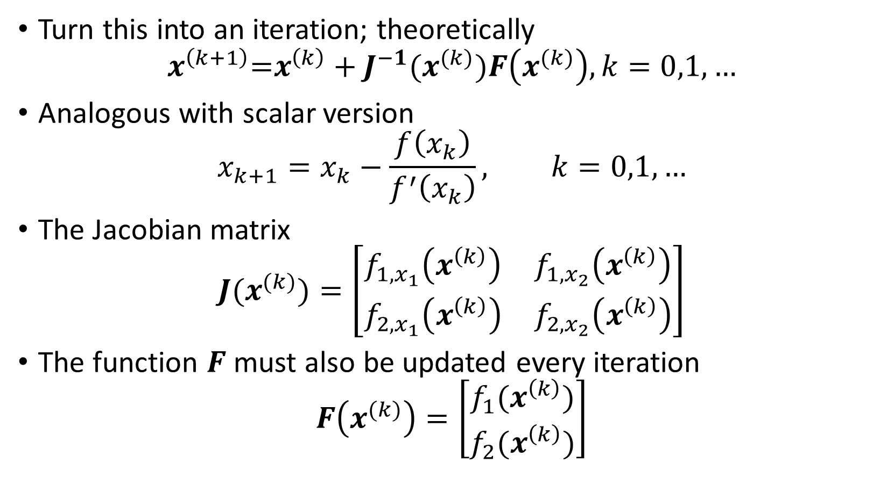
Newton’s method for systems
Turn this into an iteration; theoretically
$$x^{\left(k+1\right)}\text{=}x^{\left(k\right)}+J^{−1}(x^{(k)})F\left(x^{(k)}\right),k=0,1,…$$
Analogous with scalar version
$$x_{k+1}=x_{k}−\frac{f\left(x_{k}\right)}{f^{′}\left(x_{k}\right)}, k=0,1,…$$
The Jacobian matrix
$$J(x^{(k)})=\left[\begin{matrix}f_{1,x_{1}}\left(x^{\left(k\right)}\right) & f_{1,x_{2}}\left(x^{\left(k\right)}\right) \\ f_{2,x_{1}}\left(x^{\left(k\right)}\right) & f_{2,x_{2}}\left(x^{\left(k\right)}\right)\end{matrix}\right]$$
The function $F$ must also be updated every iteration
$$F\left(x^{(k)}\right)=\left[\begin{matrix}f_{1}(x^{\left(k\right)}) \\ f_{2}(x^{\left(k\right)})\end{matrix}\right]$$

Slide 12
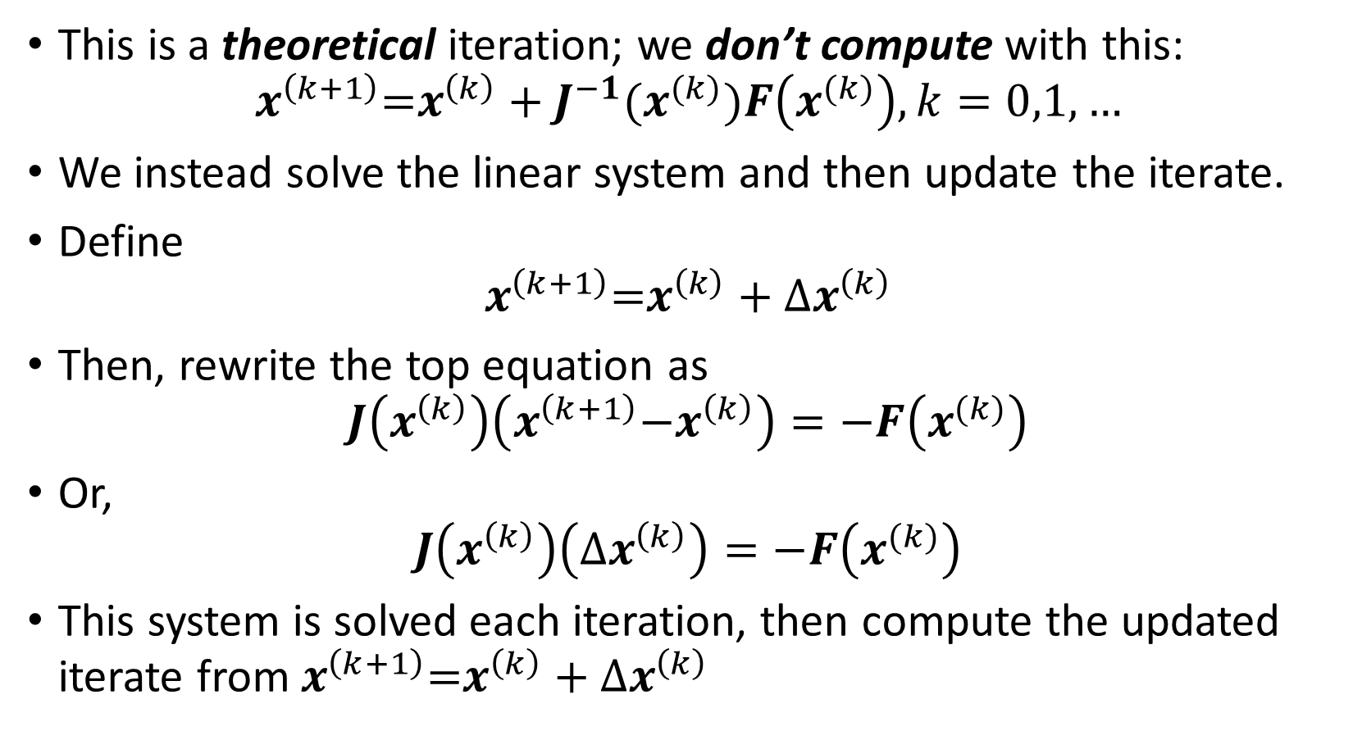
Newton’s method for systems
This is a theoretical iteration; we don’t compute with this:
$$x^{\left(k+1\right)}\text{=}x^{\left(k\right)}+J^{−1}(x^{(k)})F\left(x^{(k)}\right),k=0,1,…$$
We instead solve the linear system and then update the iterate.
Define
$$x^{\left(k+1\right)}\text{=}x^{\left(k\right)}+{Δx}^{\left(k\right)}$$
Then, rewrite the top equation as
$$J\left(x^{\left(k\right)}\right)\left(x^{\left(k+1\right)}\text{−}x^{\left(k\right)}\right)=−F\left(x^{(k)}\right)$$
Or,
$$J\left(x^{\left(k\right)}\right)\left({Δx}^{\left(k\right)}\right)=−F\left(x^{(k)}\right)$$
This system is solved each iteration, then compute the updated iterate from $x^{\left(k+1\right)}\text{=}x^{\left(k\right)}+{Δx}^{\left(k\right)}$

Slide 13
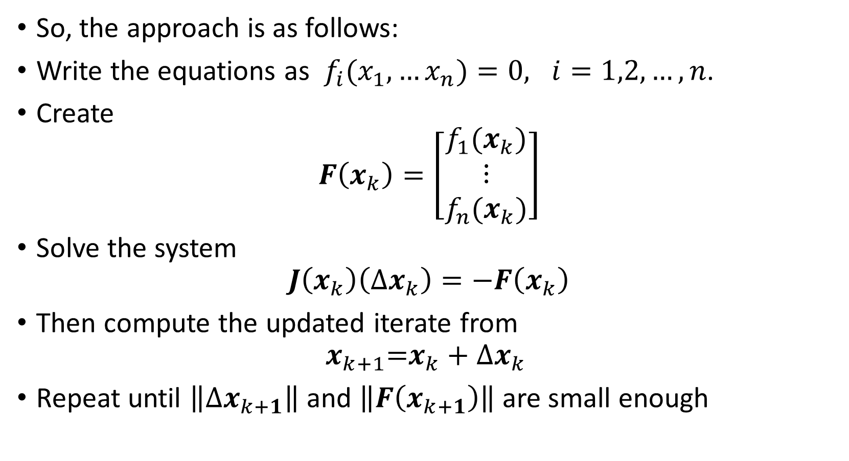
Newton’s method for systems
So, the approach is as follows:
Write the equations as $f_{i}(x_{1},…x_{n})=0, i=1,2, …,n$.
Create
$$F\left(x_{k}\right)=\left[\begin{matrix}f_{1}(x_{k}) \\ ⋮ \\ f_{n}(x_{k})\end{matrix}\right]$$
Solve the system
$$J\left(x_{k}\right)\left(Δx_{k}\right)=−F\left(x_{k}\right)$$
Then compute the updated iterate from
$$x_{k+1}\text{=}x_{k}+Δx_{k}$$
Repeat until $\left\|{Δx}_{k+1}\right\|$ and $\left\|F\left(x_{k+1}\right)\right\|$ are small enough

Slide 14
Newton’s method for systems
Example: 2x2 system

Slide 15
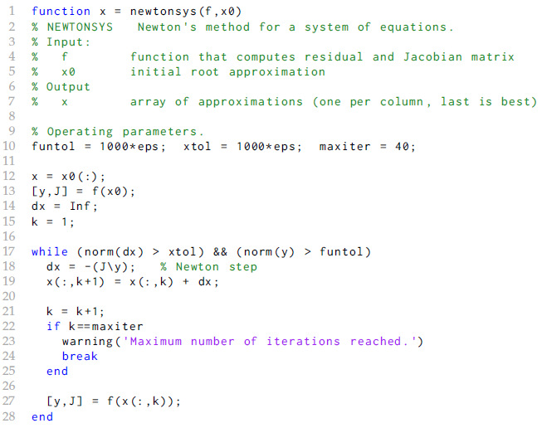
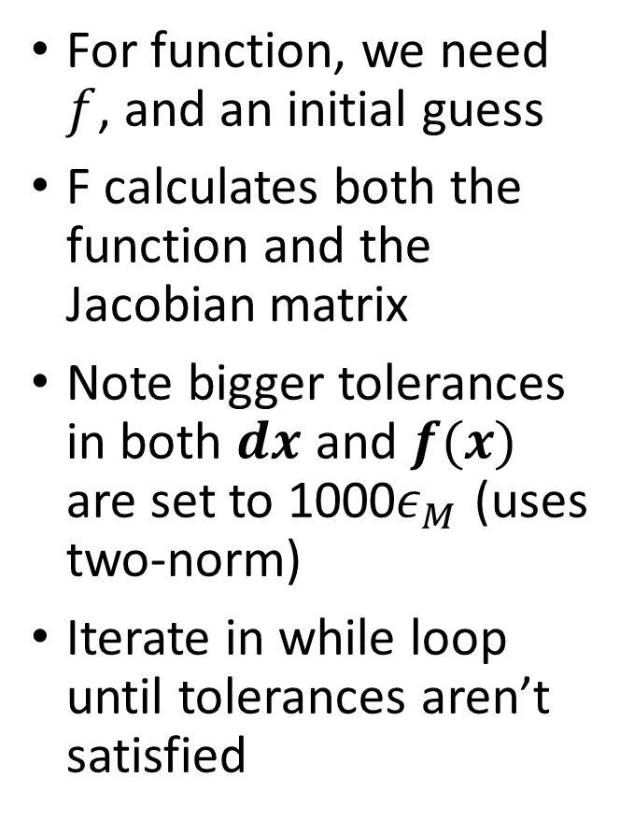
Newton’s method for systems: book code
For function, we need $f$, and an initial guess
F calculates both the function and the Jacobian matrix
Note bigger tolerances in both $dx$ and $f(x)$ are set to 1000$ε_{M}$ (uses two-norm)
Iterate in while loop until tolerances aren’t satisfied

Slide 16
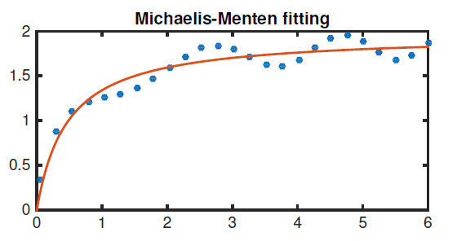
Nonlinear least squares fitting

Slide 17
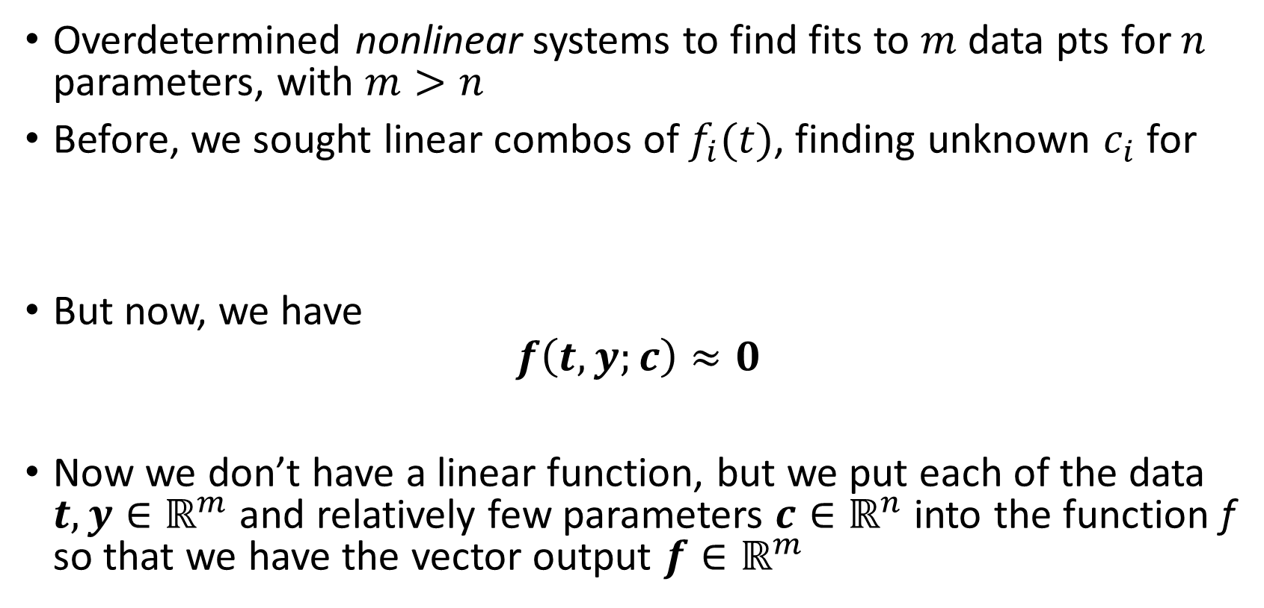
Nonlinear least squares fitting
Overdetermined nonlinear systems to find fits to $m$ data pts for $n$ parameters, with $m>n$
Before, we sought linear combos of $f_{i}(t)$, finding unknown $c_{i}$ for
But now, we have
$$f\left(t,y;c\right)≈0$$
Now we don’t have a linear function, but we put each of the data $t,y∈ℝ^{m}$ and relatively few parameters $c∈ℝ^{n}$ into the function f so that we have the vector output $f∈ℝ^{m}$

Slide 18
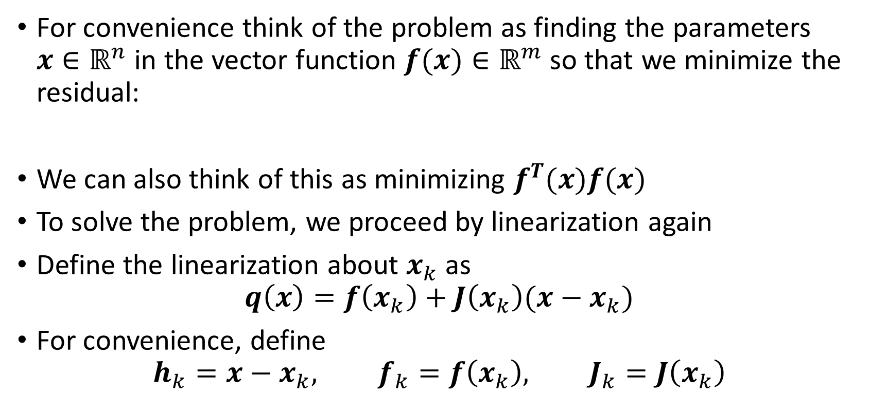
Nonlinear least squares fits
For convenience think of the problem as finding the parameters $x∈ℝ^{n}$ in the vector function $f(x)∈ℝ^{m}$ so that we minimize the residual:
We can also think of this as minimizing $f^{T}(x)f(x)$
To solve the problem, we proceed by linearization again
Define the linearization about $x_{k}$ as
$$q\left(x\right)=f\left(x_{k}\right)+J\left(x_{k}\right)(x−x_{k})$$
For convenience, define
$$h_{k}=x−x_{k}, f_{k}=f\left(x_{k}\right), J_{k}=J\left(x_{k}\right)$$

Slide 19
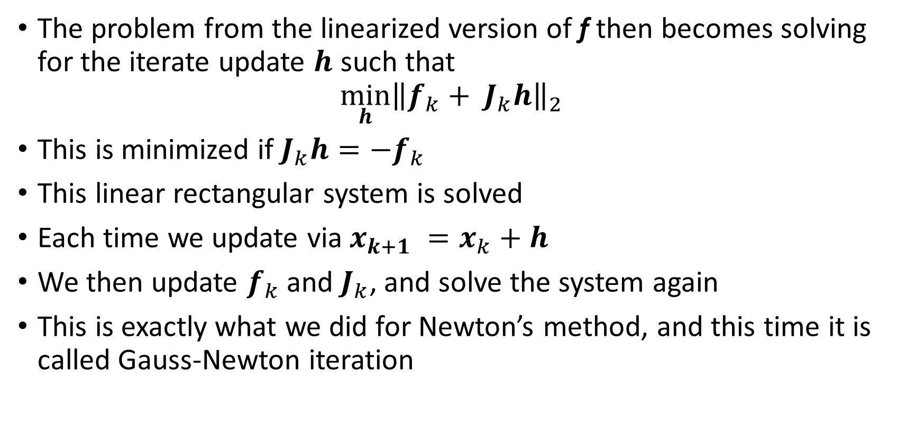
Nonlinear least squares fits
The problem from the linearized version of f then becomes solving for the iterate update $h$ such that
$$\min_{h}{{\left\|f_{k}+ J_{k}h\right\|}_{2}}$$
This is minimized if $J_{k}h=−f_{k}$
This linear rectangular system is solved
Each time we update via $x_{k+1} =x_{k}+h$
We then update $f_{k}$ and $J_{k}$, and solve the system again
This is exactly what we did for Newton’s method, and this time it is called Gauss-Newton iteration

Slide 20
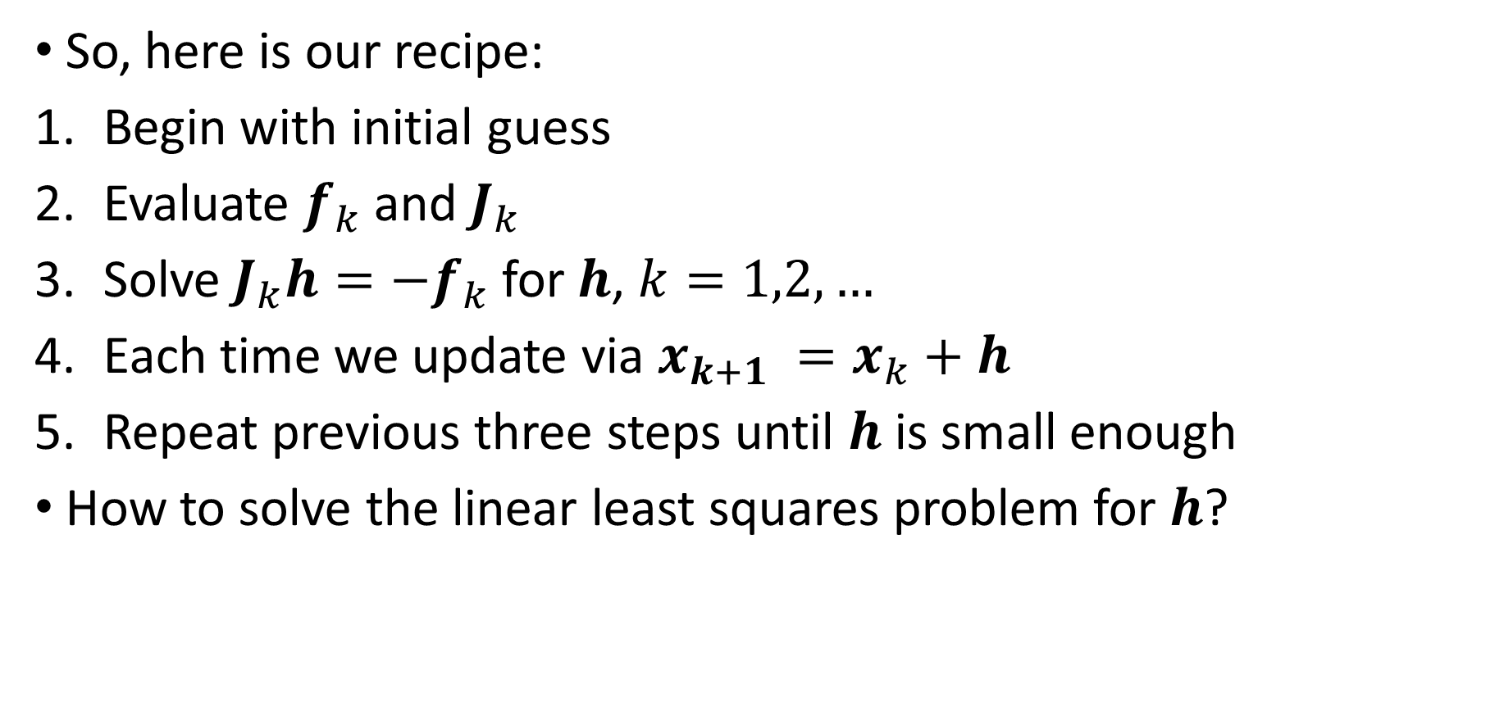
Nonlinear least squares fits – Gauss-Newton
So, here is our recipe:
Begin with initial guess
Evaluate $f_{k}$ and $J_{k}$
Solve $J_{k}h=−f_{k}$ for $h$, $k=1,2,…$
Each time we update via $x_{k+1} =x_{k}+h$
Repeat previous three steps until $h$ is small enough
How to solve the linear least squares problem for $h$?

Slide 21
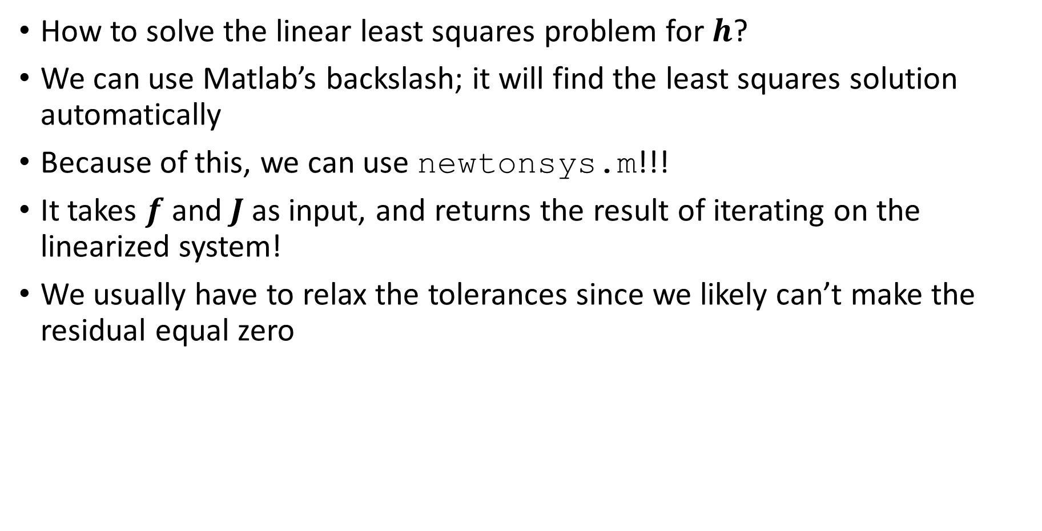
Nonlinear least squares fits – Gauss-Newton
How to solve the linear least squares problem for $h$?
We can use Matlab’s backslash; it will find the least squares solution automatically
Because of this, we can use newtonsys.m!!!
It takes $f$ and $J$ as input, and returns the result of iterating on the linearized system!
We usually have to relax the tolerances since we likely can’t make the residual equal zero

Slide 22

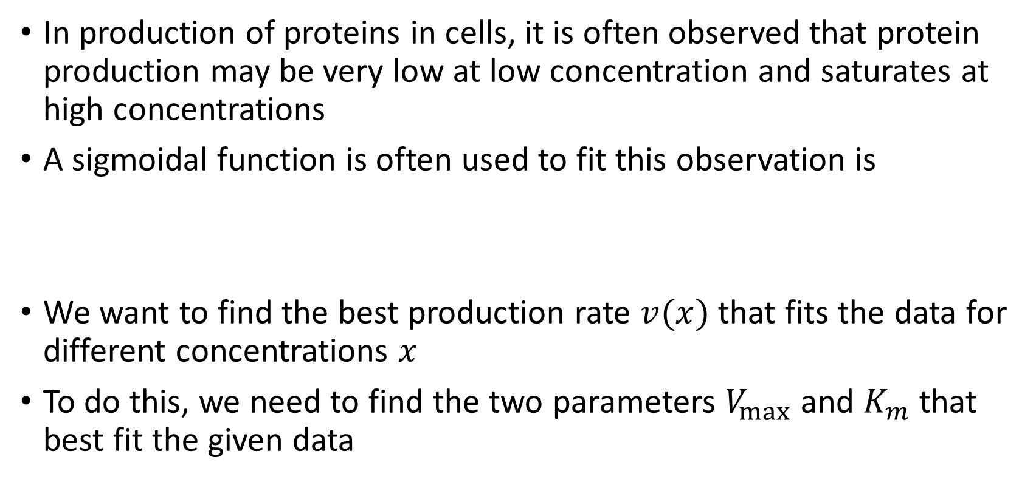
Example: Michaelis-Menten kinetics
In production of proteins in cells, it is often observed that protein production may be very low at low concentration and saturates at high concentrations
A sigmoidal function is often used to fit this observation is
We want to find the best production rate $v(x)$ that fits the data for different concentrations $x$
To do this, we need to find the two parameters $V_{max}$ and $K_{m}$ that best fit the given data

Slide 23
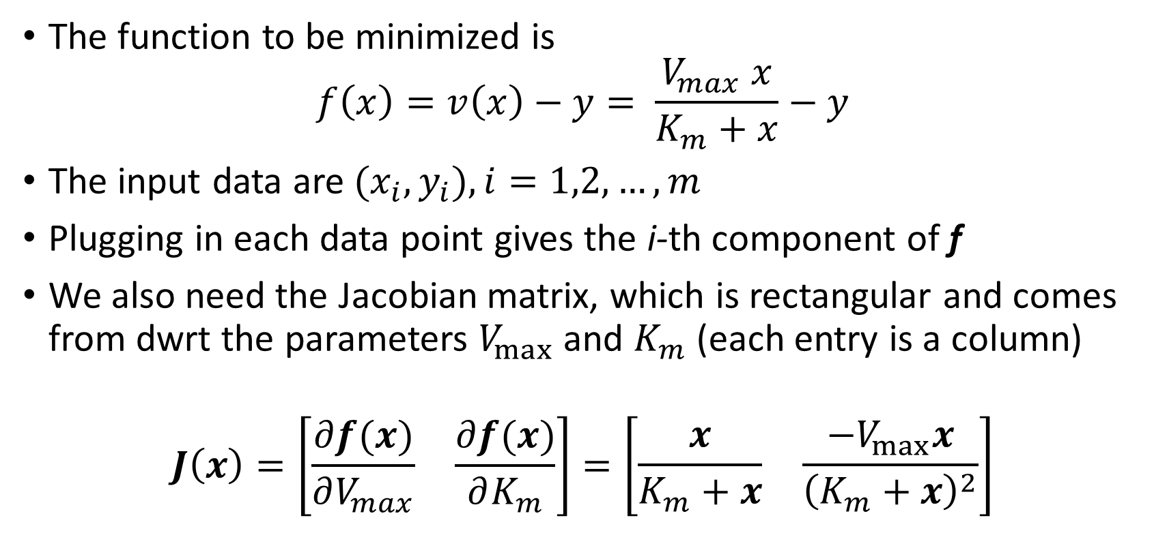
Example: Michaelis-Menten kinetics
The function to be minimized is
$$f\left(x\right)=v\left(x\right)−y= \frac{V_{max} x}{K_{m}+x}−y$$
The input data are $(x_{i},y_{i}), i=1,2,…,m$
Plugging in each data point gives the i-th component of f
We also need the Jacobian matrix, which is rectangular and comes from dwrt the parameters $V_{max}$ and $K_{m}$ (each entry is a column)
$$J\left(x\right)=\left[\begin{matrix}\frac{∂f(x)}{∂V_{max}} & \frac{∂f(x)}{∂K_{m}}\end{matrix}\right]=\left[\begin{matrix}\frac{x}{K_{m}+x} & \frac{{−V}_{max}x}{{\left(K_{m}+x\right)}^{2}}\end{matrix}\right]$$

Slide 24
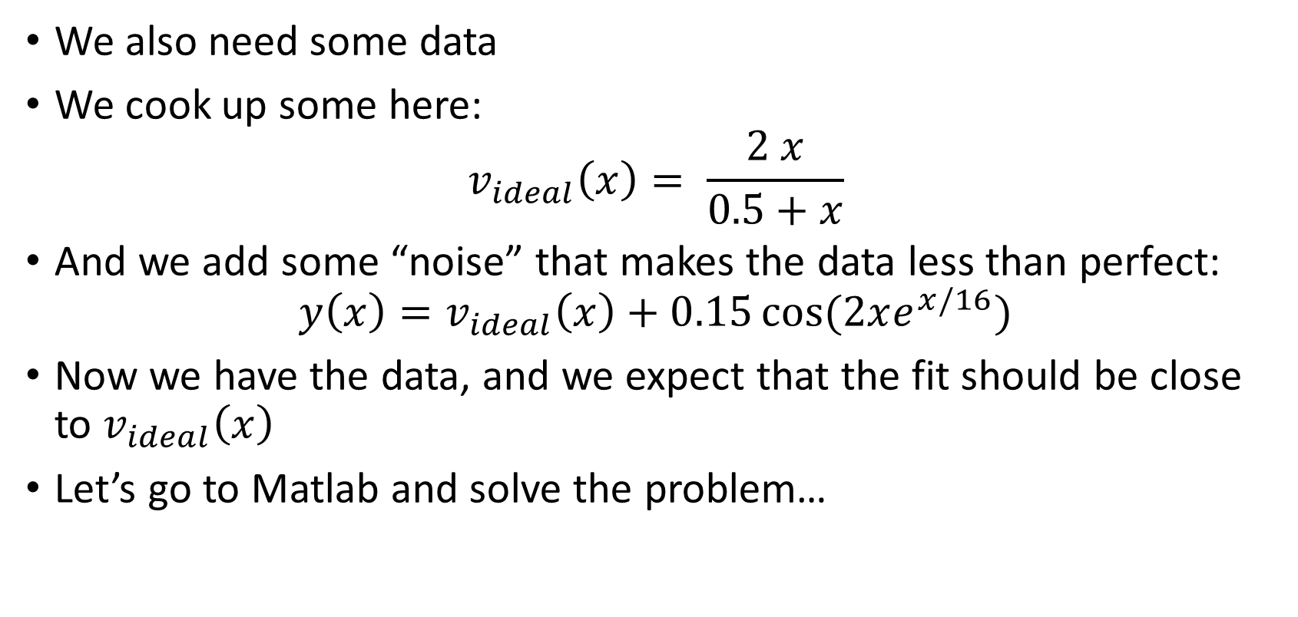
Example: Michaelis-Menten kinetics
We also need some data
We cook up some here:
$$v_{ideal}\left(x\right)= \frac{2 x}{0.5+x}$$
And we add some “noise” that makes the data less than perfect:
$$y\left(x\right)=v_{ideal}\left(x\right)+0.15\cos{(2xe^{x/16})}$$
Now we have the data, and we expect that the fit should be close to $v_{ideal}\left(x\right)$
Let’s go to Matlab and solve the problem…

Slide 25
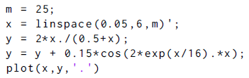
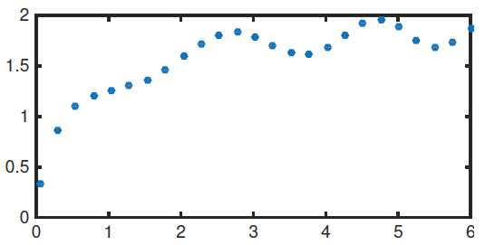
Example: Michaelis-Menten kinetics
Create the data:
Here’s how it looks:

Slide 26
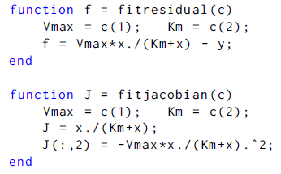
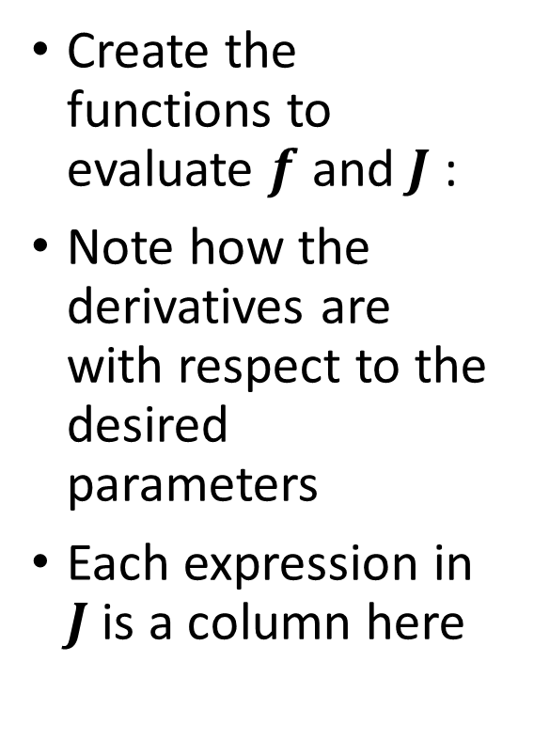
Example: Michaelis-Menten kinetics
Create the functions to evaluate $f$ and $J$ :
Note how the derivatives are with respect to the desired parameters
Each expression in $J$ is a column here

Slide 27
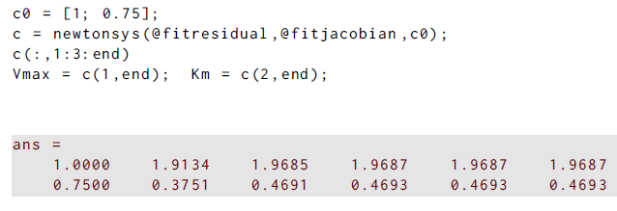
Michaelis-Menten ex
Solve the problem:
Here’s how it looks:
The last values of the parameters are close to the (2,0.5) we started with

Slide 28
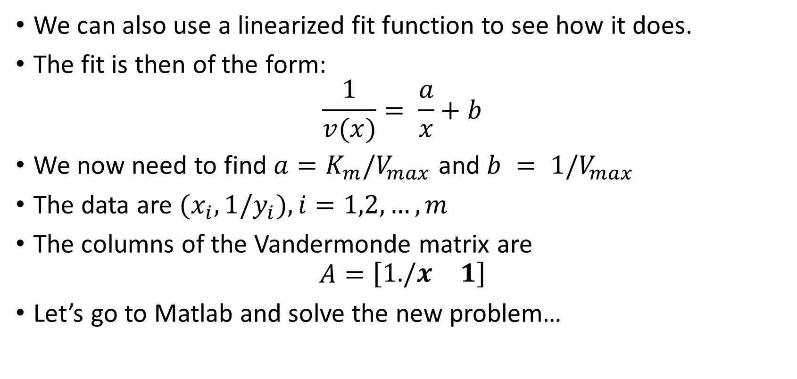
Example: Michaelis-Menten kinetics
We can also use a linearized fit function to see how it does.
The fit is then of the form:
$$\frac{1}{v(x)}= \frac{a}{x}+b$$
We now need to find $a=K_{m}/V_{max}$ and $b = 1/V_{max}$
The data are $(x_{i},1/y_{i}), i=1,2,…,m$
The columns of the Vandermonde matrix are
$$A=\left[\begin{matrix}1./x & 1\end{matrix}\right]$$
Let’s go to Matlab and solve the new problem…

Slide 29

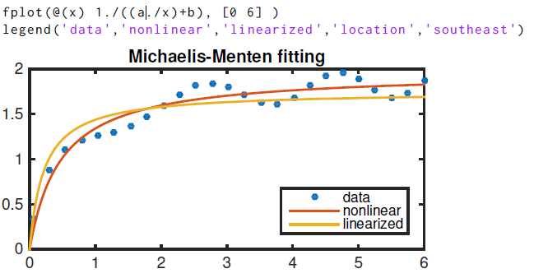
Michaelis-Menten ex
Solve the problem:
Here’s how it looks:
Fit is worse than for NL version
Residual worse, now 0.7487 (last time 0.5234)

Slide 30
Example: Michaelis-Menten kinetics
The linearized fit is worse than the nonlinear fit
The linearized fit minimizes a different quantity than the nonlinear version
Result is less faithful to original data than nonlinear version
This is a classic example of this issue, but it is very common.
Let’s try it out.

Slide 31
Quasi-Newton Methods for Systems

Slide 32

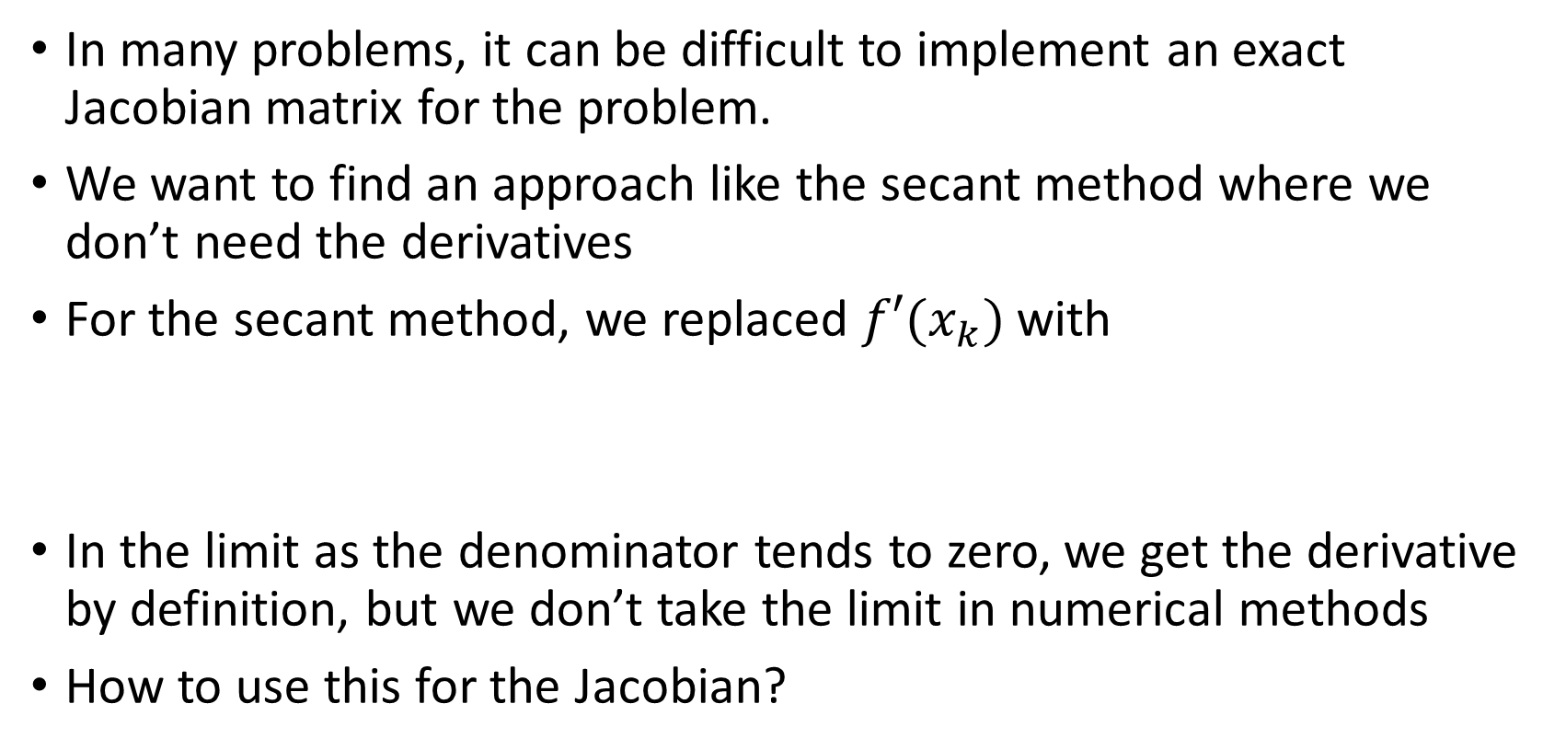
Quasi-Newton methods
In many problems, it can be difficult to implement an exact Jacobian matrix for the problem.
We want to find an approach like the secant method where we don’t need the derivatives
For the secant method, we replaced $f′(x_{k})$ with
In the limit as the denominator tends to zero, we get the derivative by definition, but we don’t take the limit in numerical methods
How to use this for the Jacobian?

Slide 33
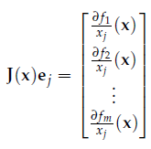

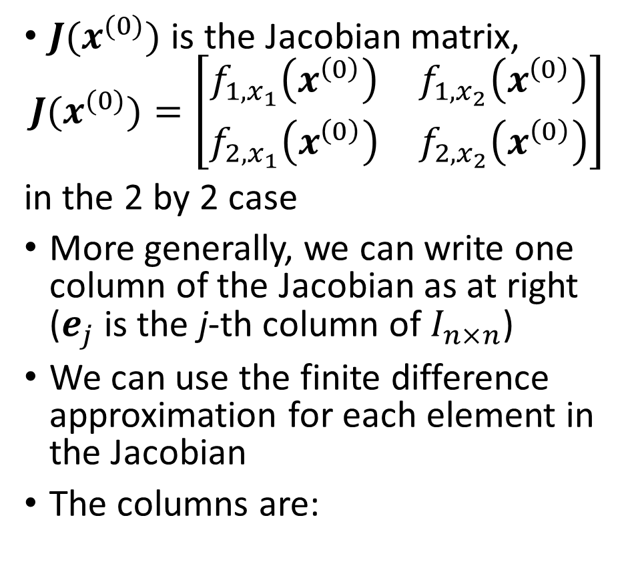
Quasi-Newton methods
$J(x^{(0)})$ is the Jacobian matrix,
$$J(x^{(0)})=\left[\begin{matrix}f_{1,x_{1}}\left(x^{\left(0\right)}\right) & f_{1,x_{2}}\left(x^{\left(0\right)}\right) \\ f_{2,x_{1}}\left(x^{\left(0\right)}\right) & f_{2,x_{2}}\left(x^{\left(0\right)}\right)\end{matrix}\right]$$
in the 2 by 2 case
More generally, we can write one column of the Jacobian as at right ($e_{j}$ is the j-th column of $I_{n×n}$)
We can use the finite difference approximation for each element in the Jacobian
The columns are:

Slide 34
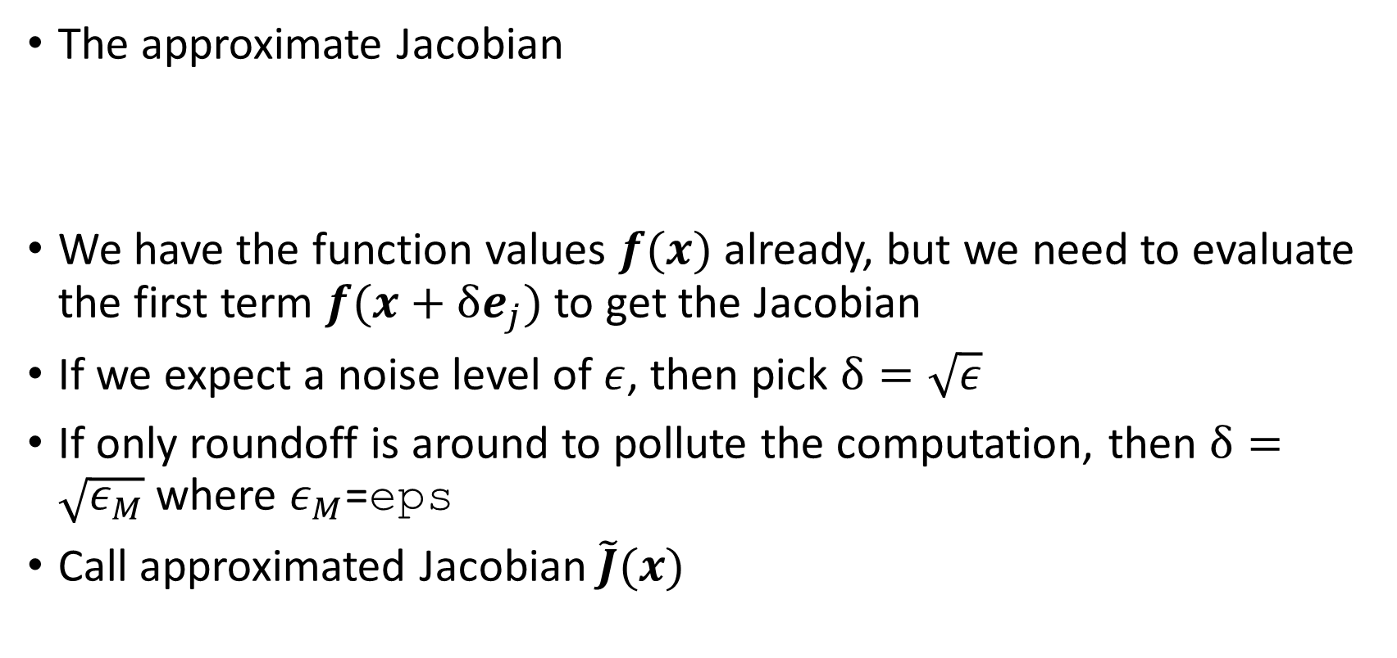
Quasi-Newton methods
The approximate Jacobian
We have the function values $f(x)$ already, but we need to evaluate the first term $f(x+δe_{j})$ to get the Jacobian
If we expect a noise level of $ε$, then pick $δ=\sqrt{ε}$
If only roundoff is around to pollute the computation, then $δ=\sqrt{ε_{M}}$ where $ε_{M}$=eps
Call approximated Jacobian $\tilde{J}(x)$

Slide 35
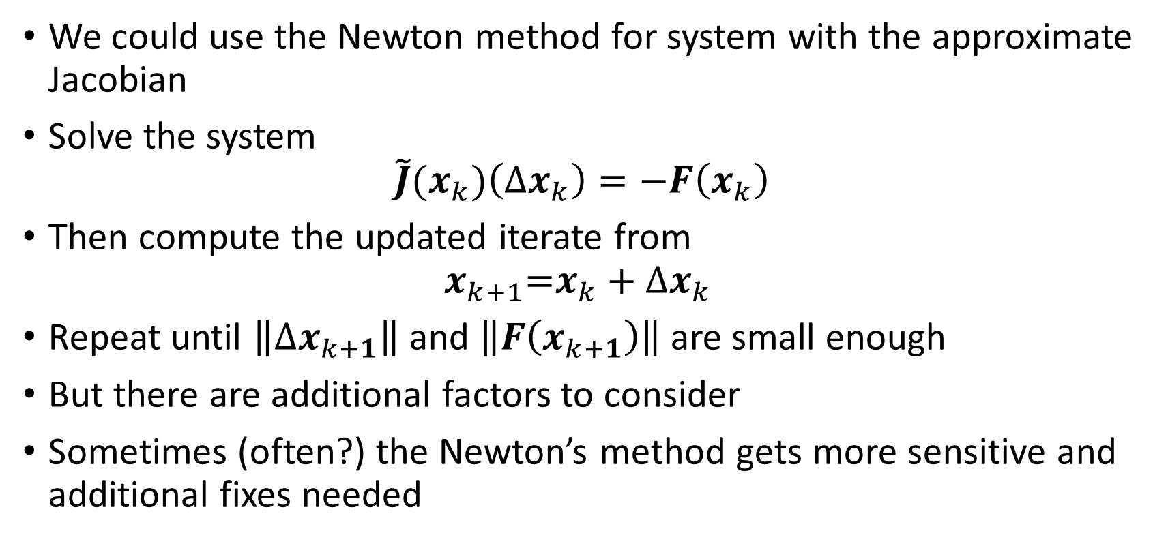
Quasi-Newton methods
We could use the Newton method for system with the approximate Jacobian
Solve the system
$$\tilde{J}(x_{k})\left(Δx_{k}\right)=−F\left(x_{k}\right)$$
Then compute the updated iterate from
$$x_{k+1}\text{=}x_{k}+Δx_{k}$$
Repeat until $\left\|{Δx}_{k+1}\right\|$ and $\left\|F\left(x_{k+1}\right)\right\|$ are small enough
But there are additional factors to consider
Sometimes (often?) the Newton’s method gets more sensitive and additional fixes needed

Slide 36

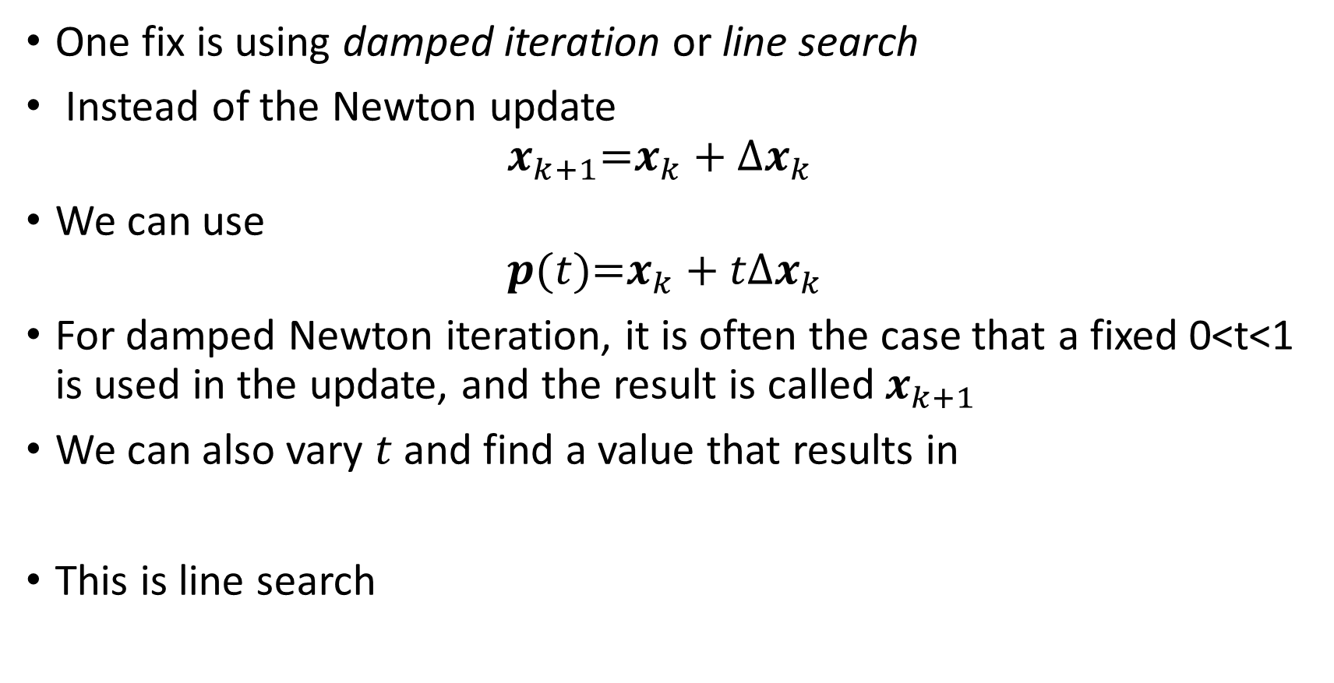
Quasi-Newton methods
One fix is using damped iteration or line search
Instead of the Newton update
$$x_{k+1}\text{=}x_{k}+Δx_{k}$$
We can use
$$p(t)\text{=}x_{k}+tΔx_{k}$$
For damped Newton iteration, it is often the case that a fixed 0<t<1 is used in the update, and the result is called $x_{k+1}$
We can also vary $t$ and find a value that results in
This is line search

Slide 37
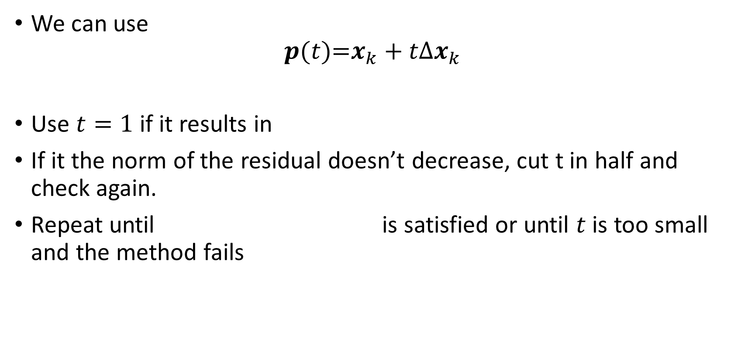
Quasi-Newton methods
We can use
$$p(t)\text{=}x_{k}+tΔx_{k}$$
Use $t=1$ if it results in
If it the norm of the residual doesn’t decrease, cut t in half and check again.
Repeat until is satisfied or until $t$ is too small and the method fails

Slide 38
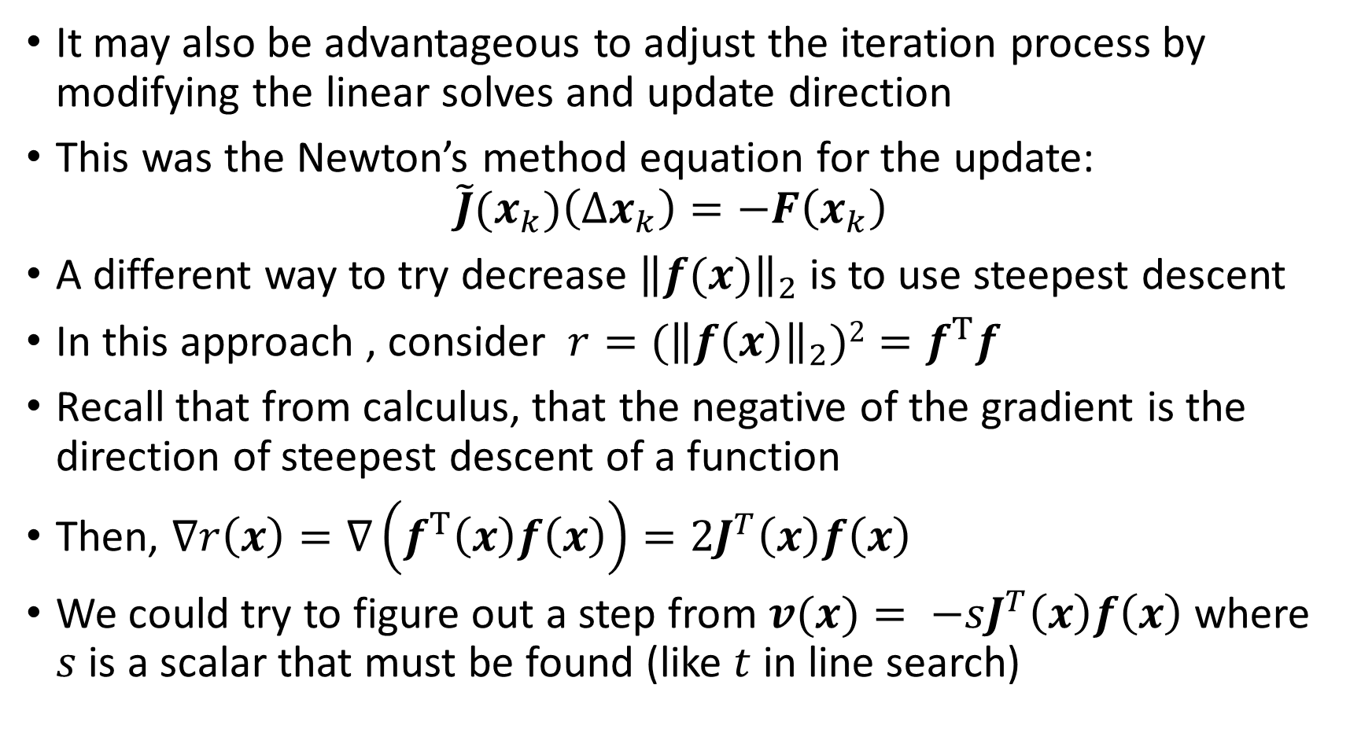
Quasi-Newton: Levenberg’s method
It may also be advantageous to adjust the iteration process by modifying the linear solves and update direction
This was the Newton’s method equation for the update:
$$\tilde{J}(x_{k})\left(Δx_{k}\right)=−F\left(x_{k}\right)$$
A different way to try decrease ${\left\|f(x)\right\|}_{2}$ is to use steepest descent
In this approach , consider $r={(\left\|f\left(x\right)\right\|}_{2})2=f^{T}f$
Recall that from calculus, that the negative of the gradient is the direction of steepest descent of a function
Then, $∇r\left(x\right)=∇\left(f^{T}\left(x\right)f\left(x\right)\right)=2J^{T}\left(x\right)f\left(x\right)$
We could try to figure out a step from $v(x)= −sJ^{T}\left(x\right)f\left(x\right)$ where $s$ is a scalar that must be found (like $t$ in line search)

Slide 39
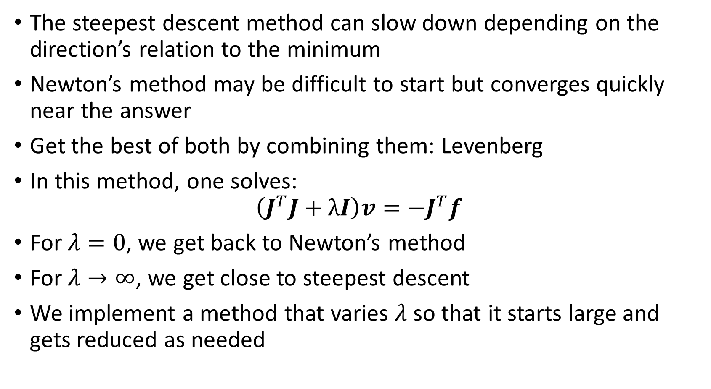
Quasi-Newton: Levenberg’s method
The steepest descent method can slow down depending on the direction’s relation to the minimum
Newton’s method may be difficult to start but converges quickly near the answer
Get the best of both by combining them: Levenberg
In this method, one solves:
$$\left(J^{T}J+λI\right)v=−J^{T}f$$
For $λ=0$, we get back to Newton’s method
For $λ→∞$, we get close to steepest descent
We implement a method that varies $λ$ so that it starts large and gets reduced as needed

Slide 40
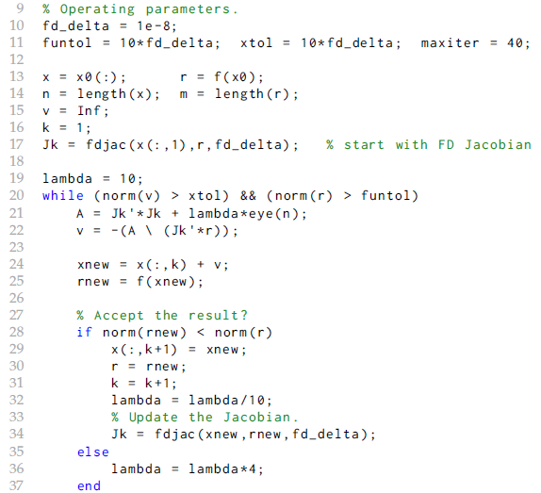
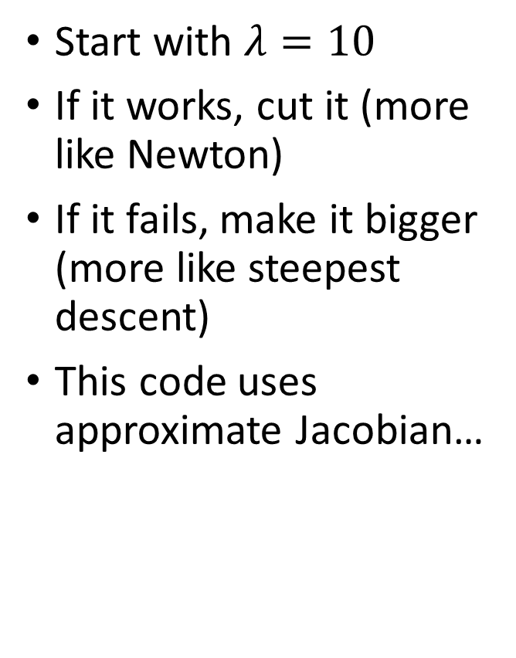
Levenberg’s method
Start with $λ=10$
If it works, cut it (more like Newton)
If it fails, make it bigger (more like steepest descent)
This code uses approximate Jacobian…

Slide 41
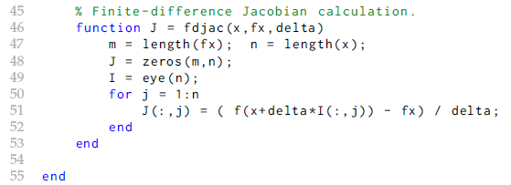
Levenberg’s method
This code uses approximate Jacobian…
Let’s do an example

Slide 42
Example: Michaelis-Menten kinetics
Create the data:
Here’s how it looks:

Slide 43
Example: Michaelis-Menten kinetics
Create the functions to evaluate $f$ and $J$ :
Note how the derivatives are with respect to the desired parameters
Each expression in $J$ is a column here

Slide 44
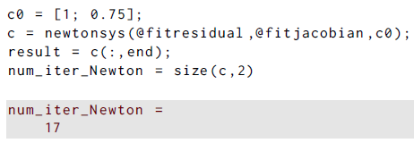
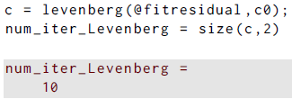
Michaelis-Menten ex
Solve the problem and note the iterations req’d:
Using Levenberg’s method only takes 10 iterations

Slide 45

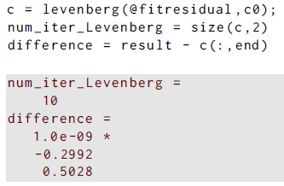
Michaelis-Menten ex
Solve the problem with a new guess; this time it fails:
Using Levenberg’s method is barely affected, with about 1e-9 difference in the answer:

Slide 46
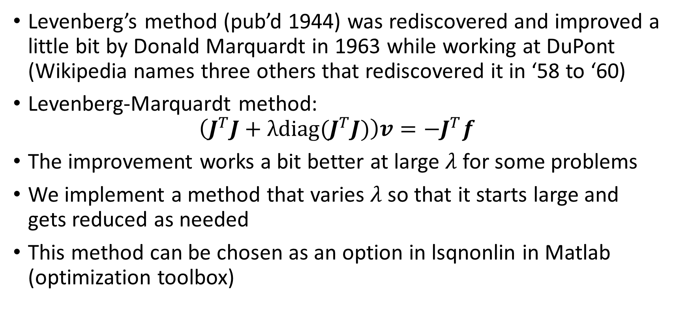
Quasi-Newton methods
Levenberg’s method (pub’d 1944) was rediscovered and improved a little bit by Donald Marquardt in 1963 while working at DuPont (Wikipedia names three others that rediscovered it in ‘58 to ‘60)
Levenberg-Marquardt method:
$$\left(J^{T}J+λdiag(J^{T}J)\right)v=−J^{T}f$$
The improvement works a bit better at large $λ$ for some problems
We implement a method that varies $λ$ so that it starts large and gets reduced as needed
This method can be chosen as an option in lsqnonlin in Matlab (optimization toolbox)

